Slide 1







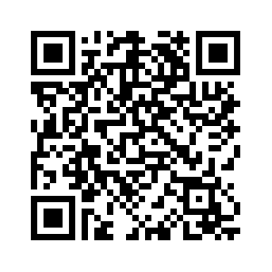


Slide 2



Gavin Clark
Skye Yang

Slide 3




Slide 4

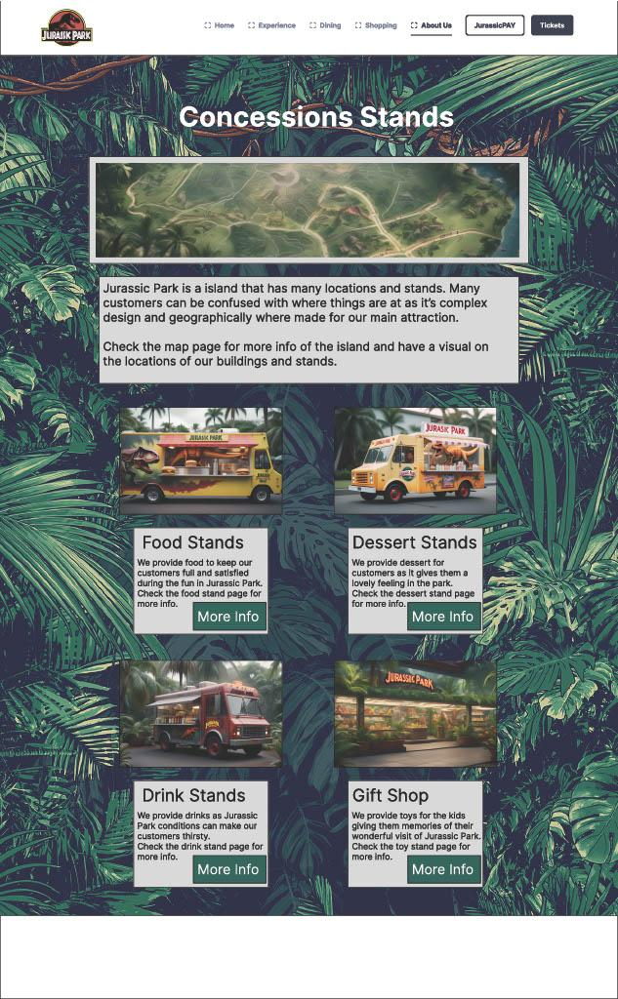
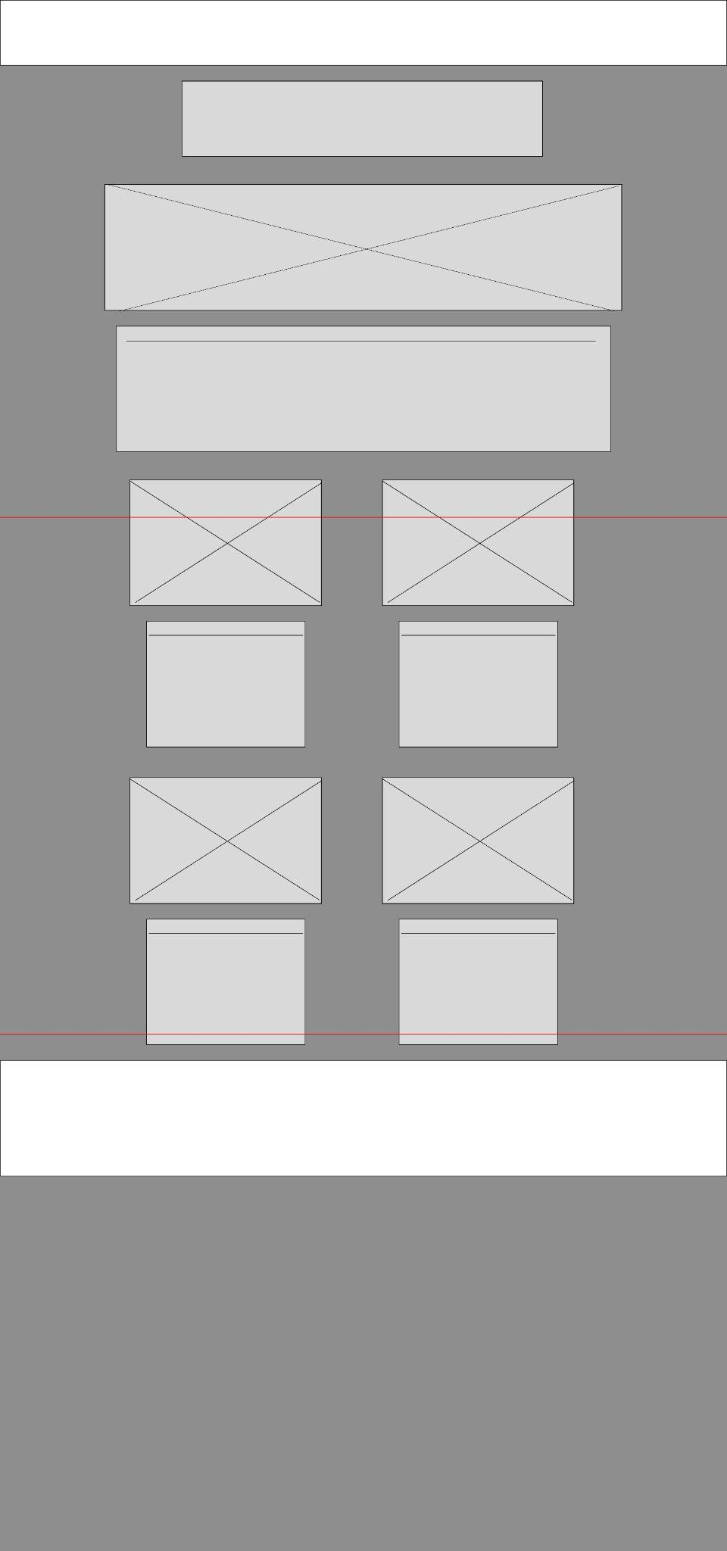

Beginning of the website
Our Research
Figma Wireframe

Slide 5

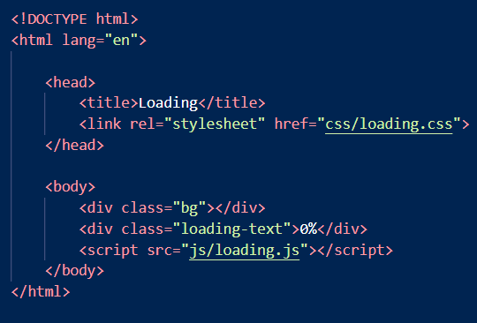
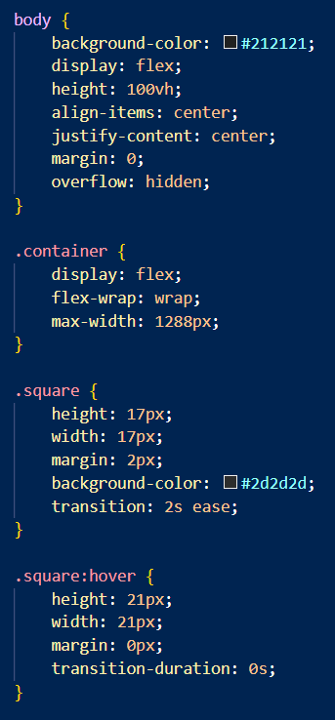
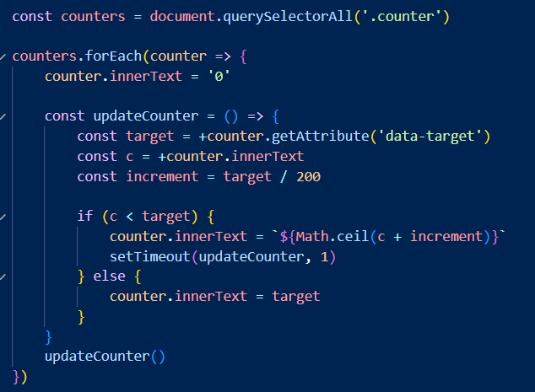

The inner workings of the website
HTML (Hypertext Markup Language)
CSS (Cascading Style Sheet)
JavaScript

Slide 6

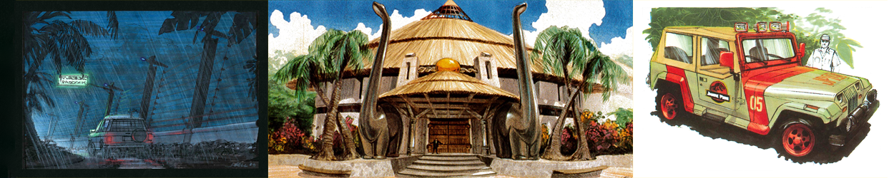
We had three things in mind for the pages for the website.
Navigation
Map
Stands

Slide 7


Everything in our website

Slide 8
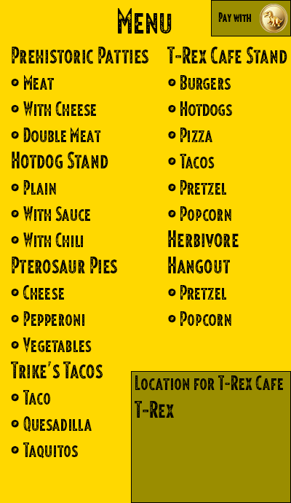

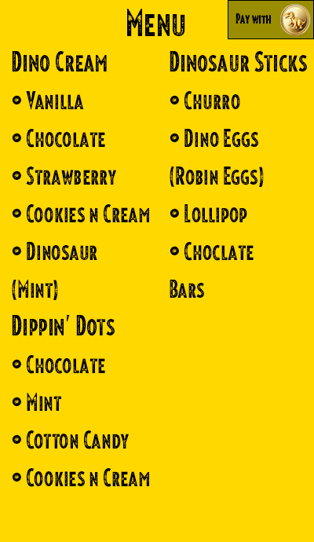
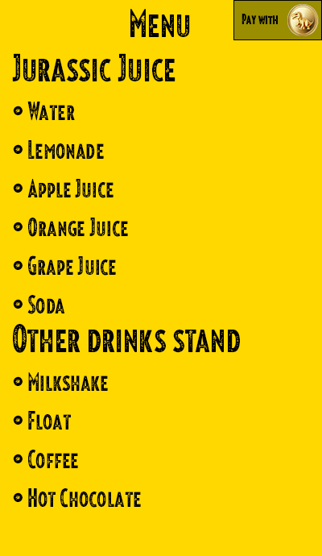
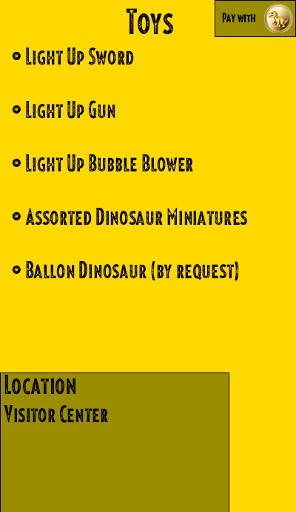
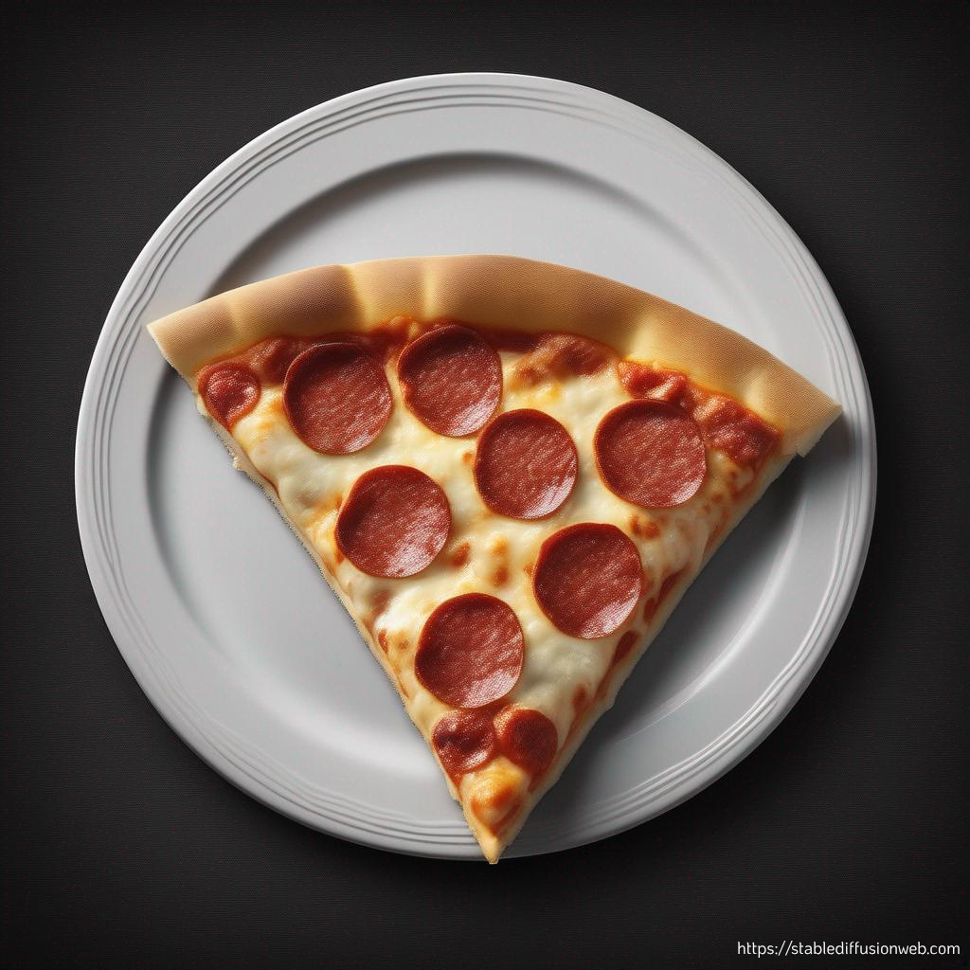
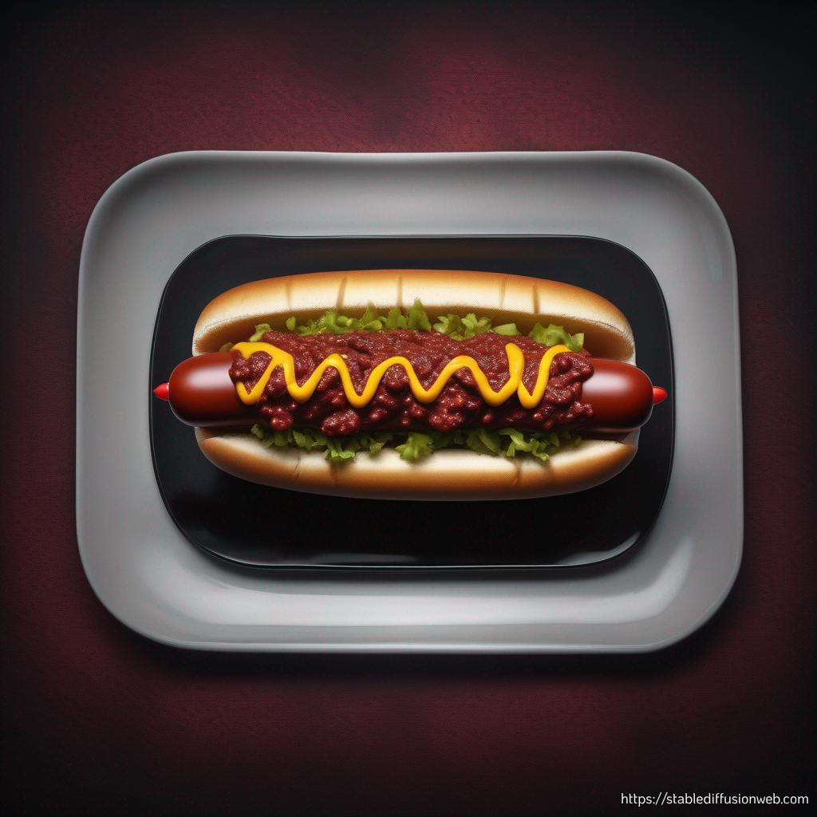

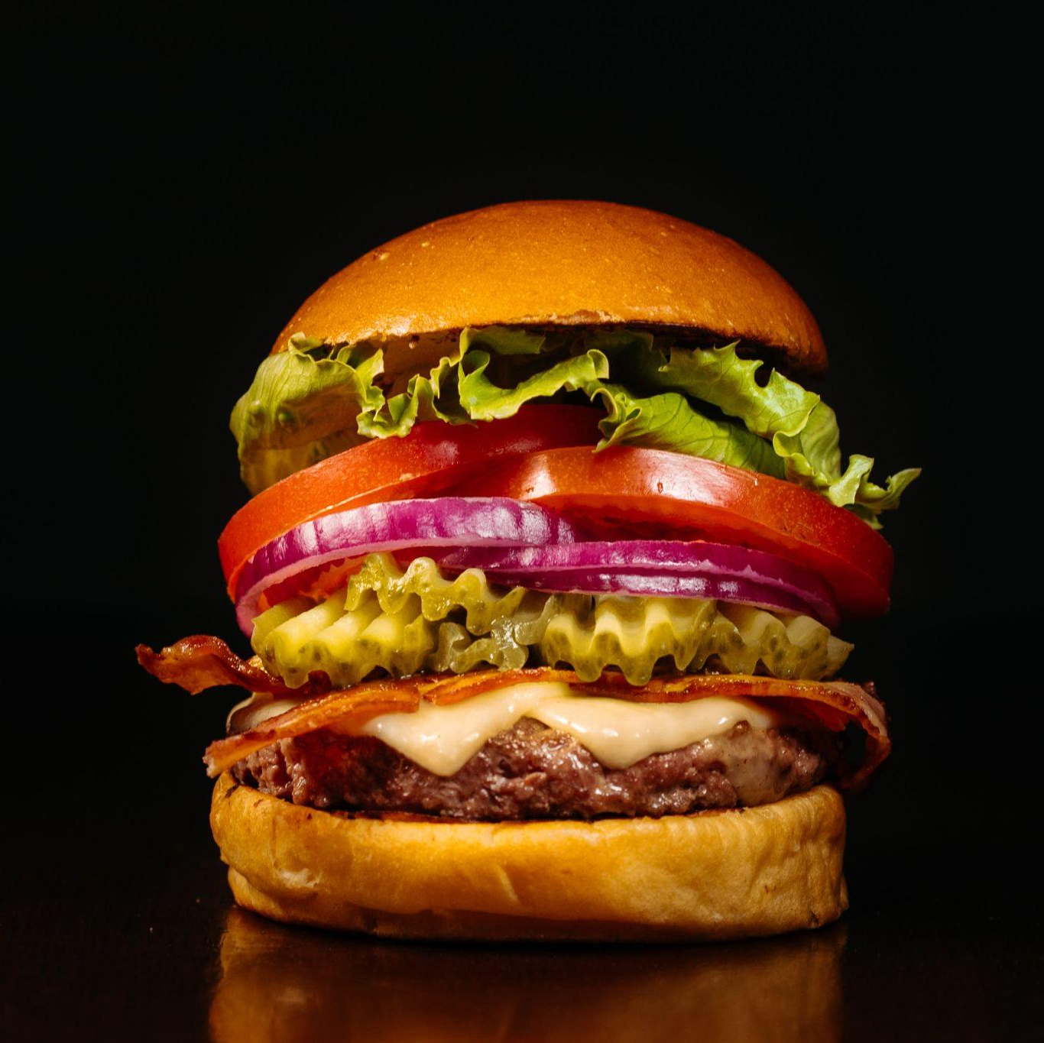

Navigation
Map
Food Stands
Dessert Stand
Drink Stand
Gift Shop
Each stand has a Shopping Cart

Slide 9
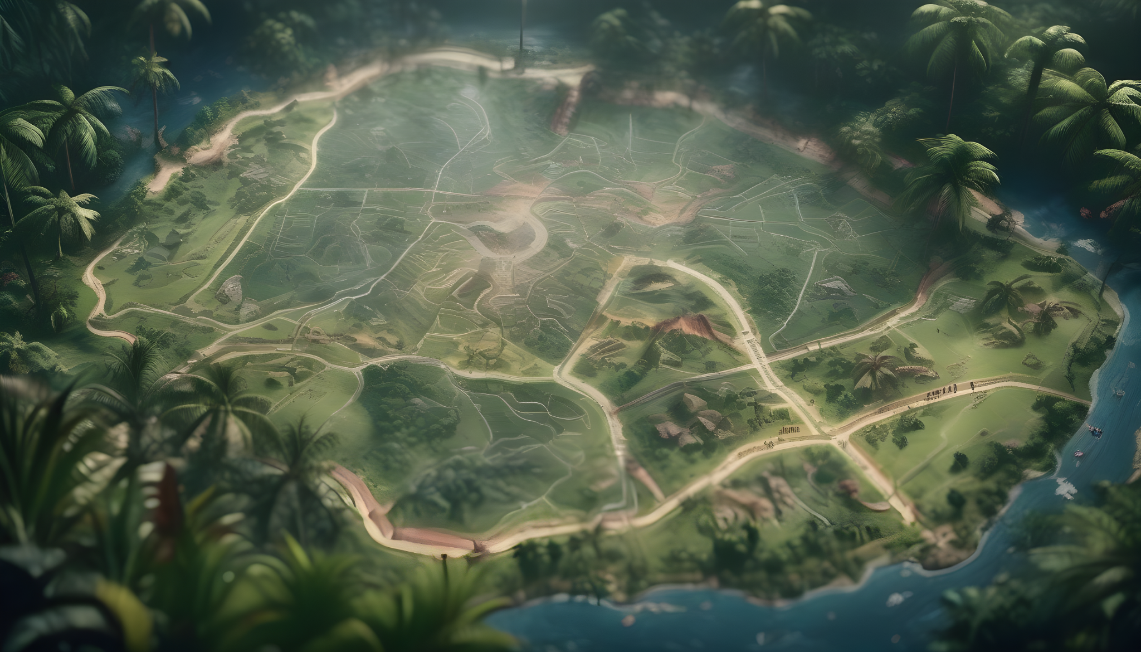
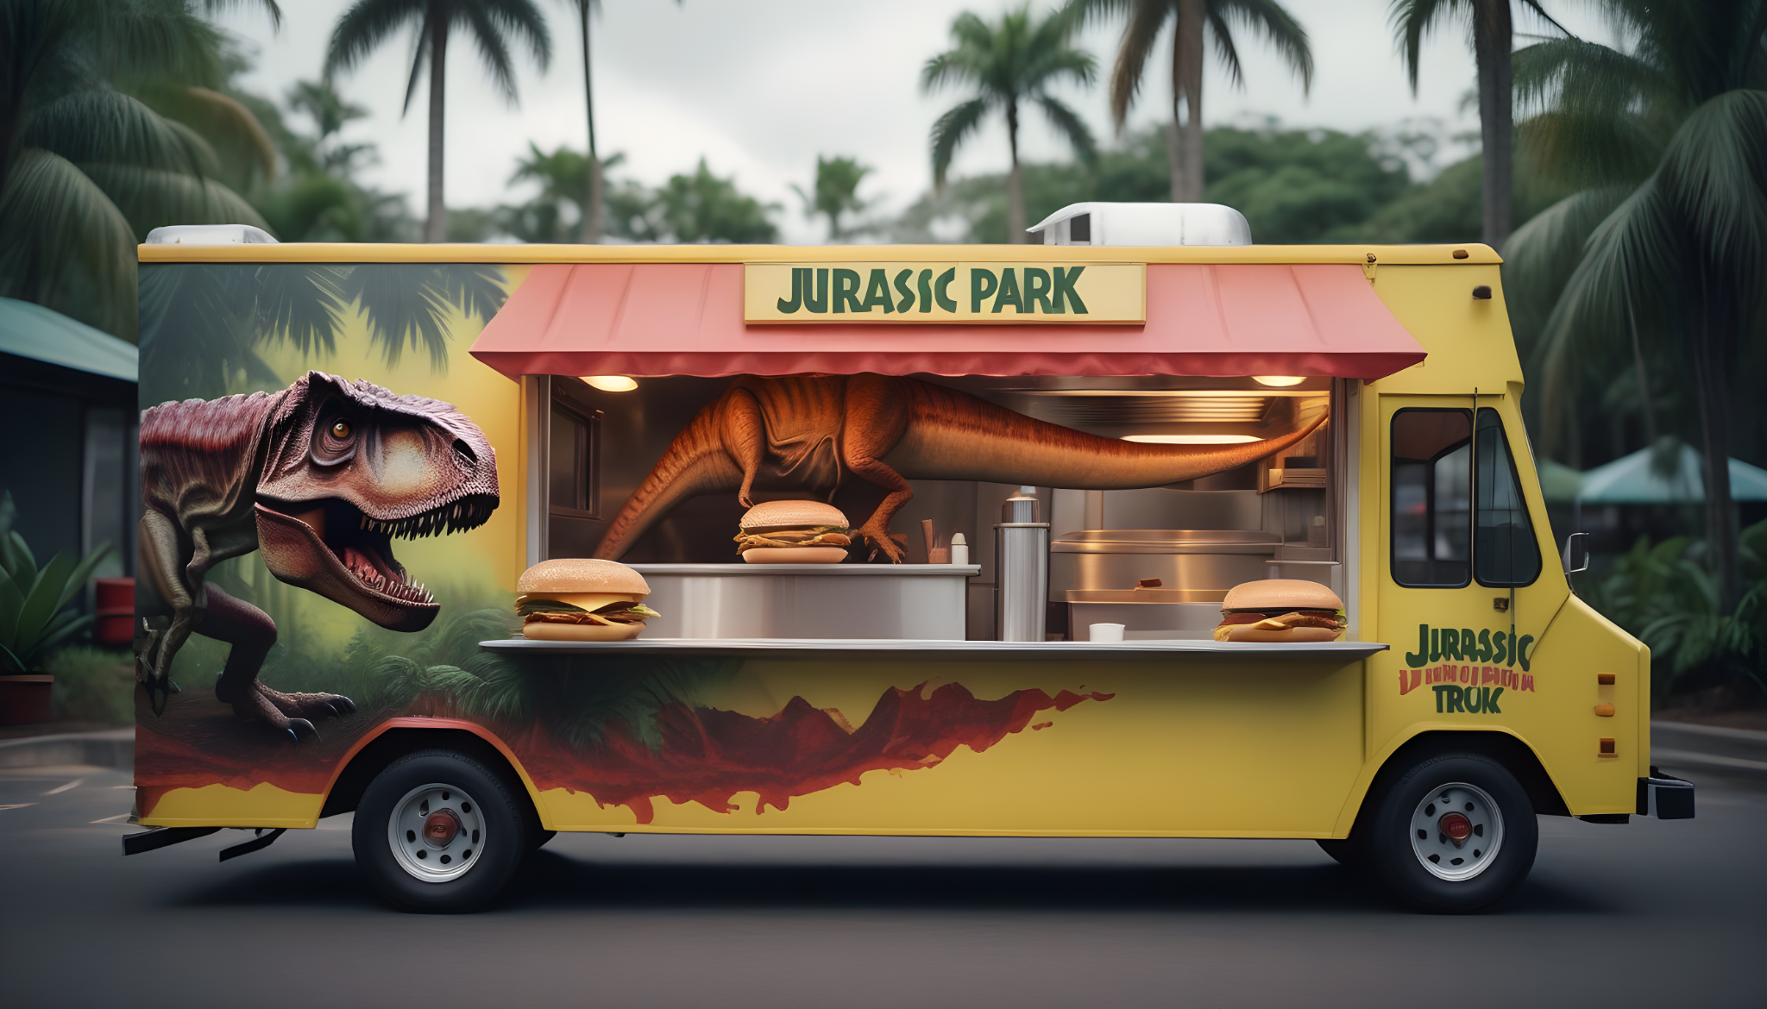
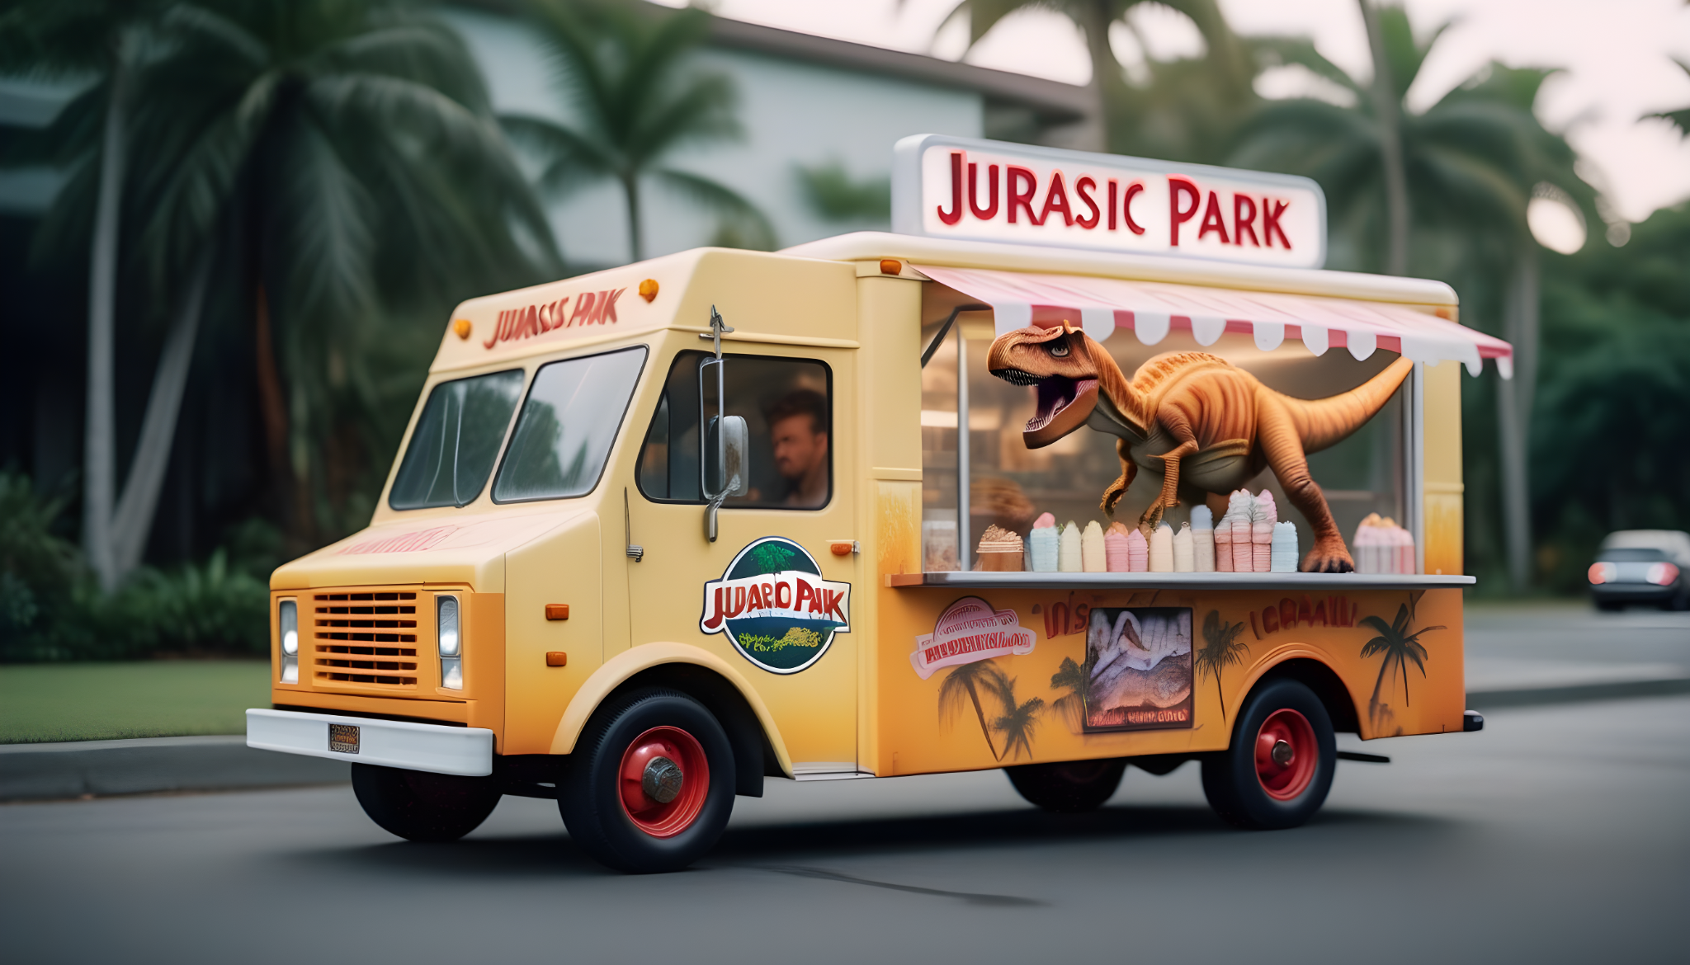
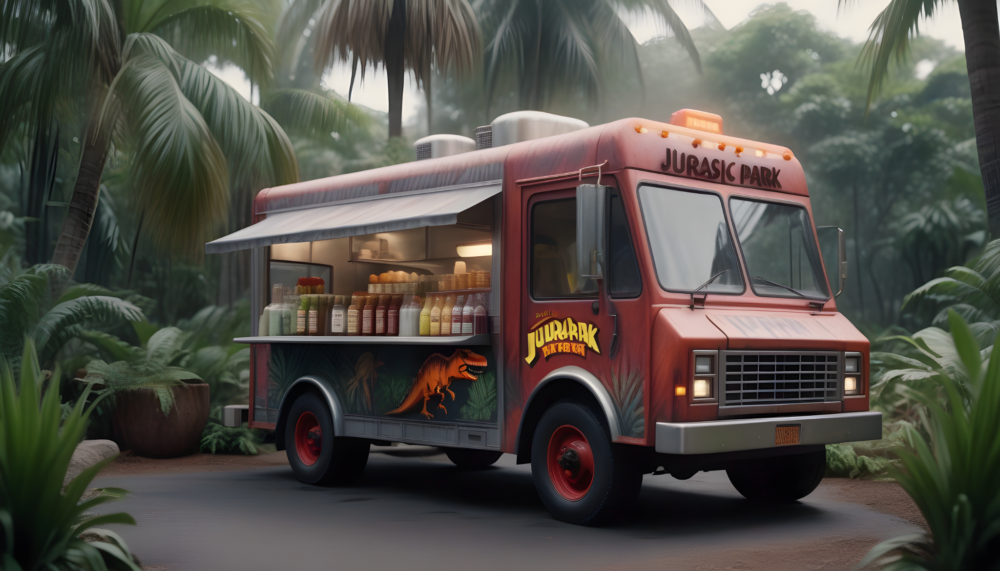
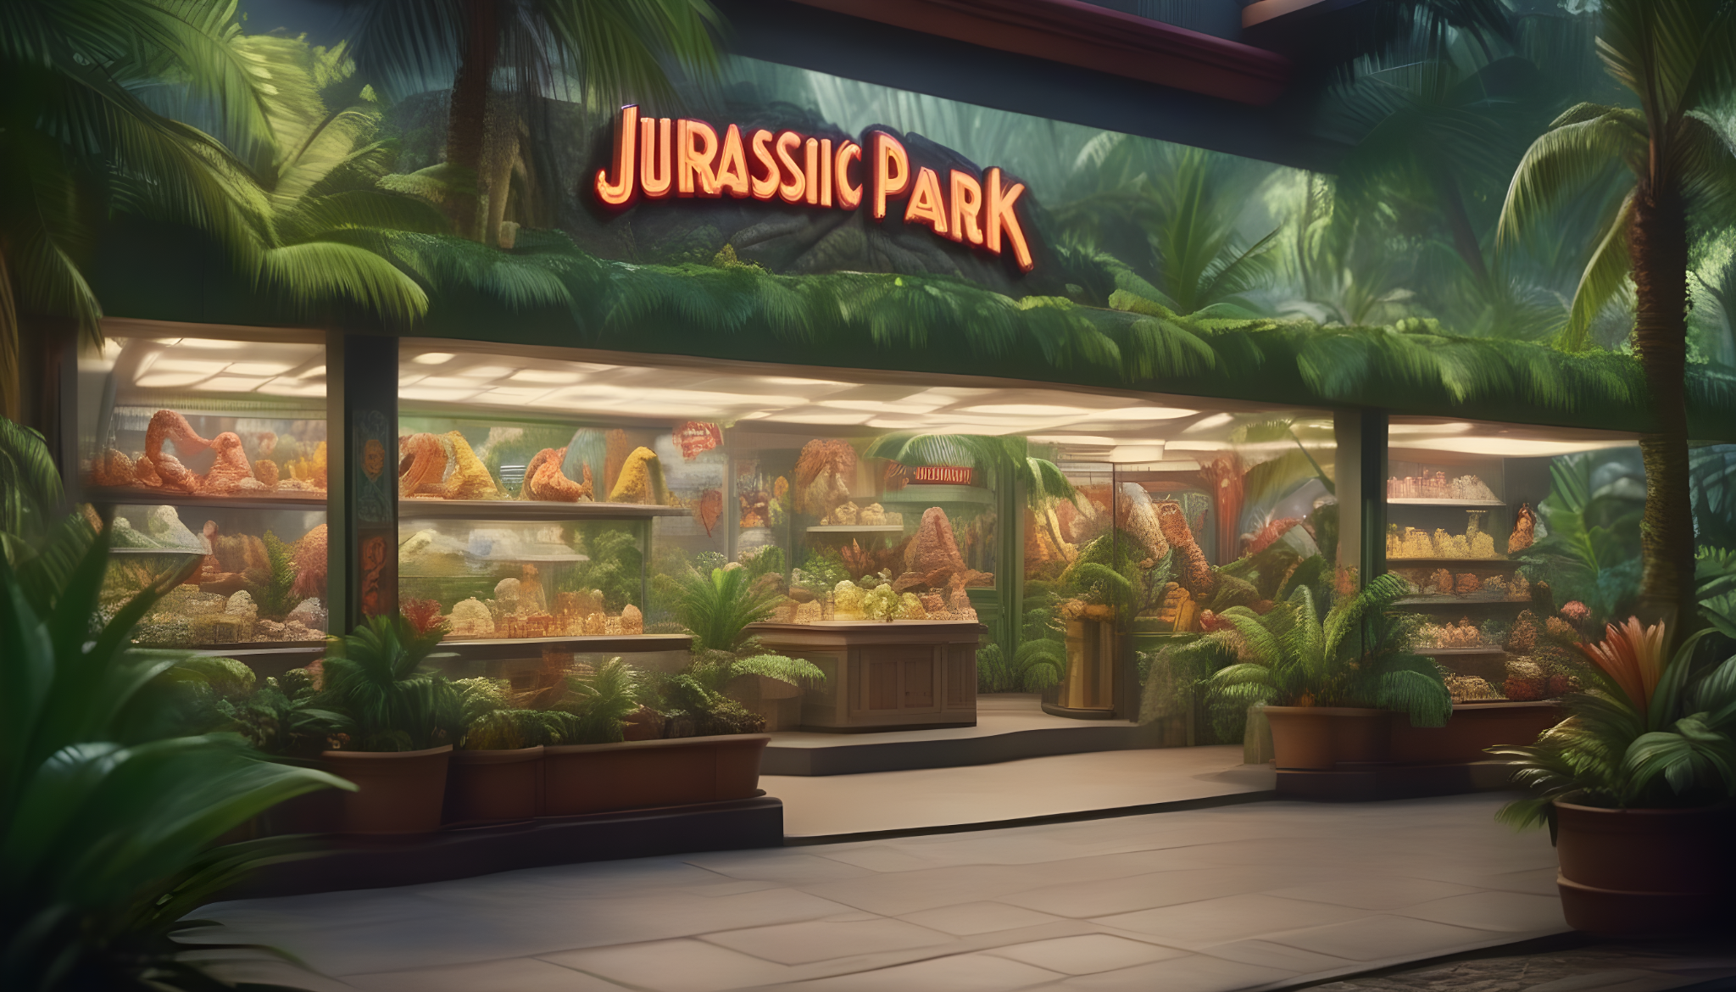

Slide 10

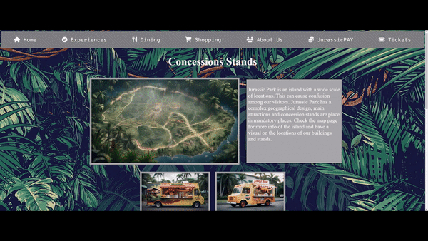
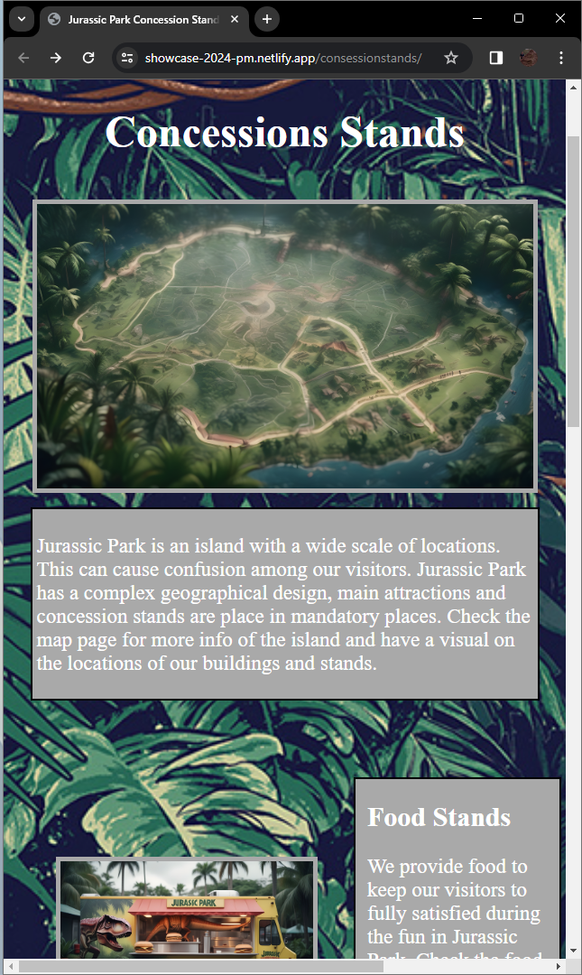
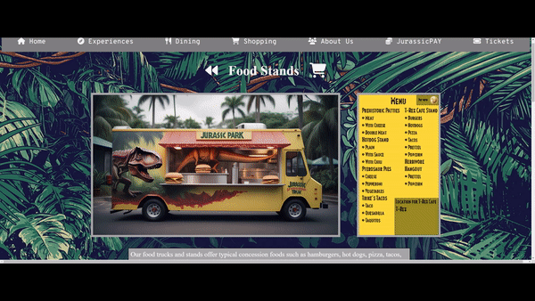
Mobile
Desktop

Slide 11

Don’t procrastinate
The best product needs everyone’s effort.
Accomplishing something big feels pretty good

Slide 12

Cart feature
We want to finish our cart feature so people can use a functional buying system.
Organization
Our site can use a little bit of fine tuning in terms of organization.
Map
Add some icons of the stands to the page for users to click on like Disney’s phone app.

Slide 13
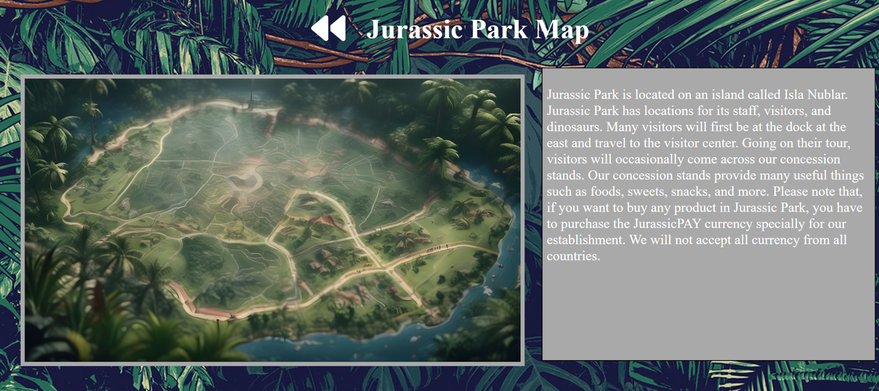
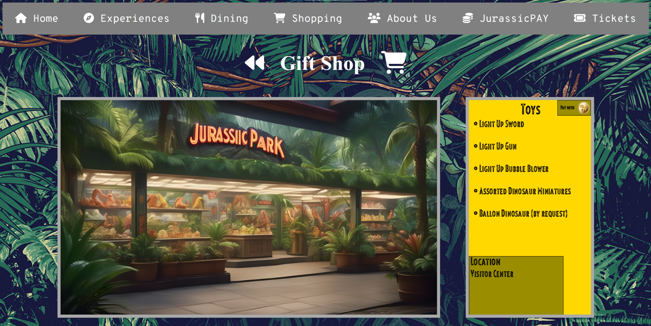
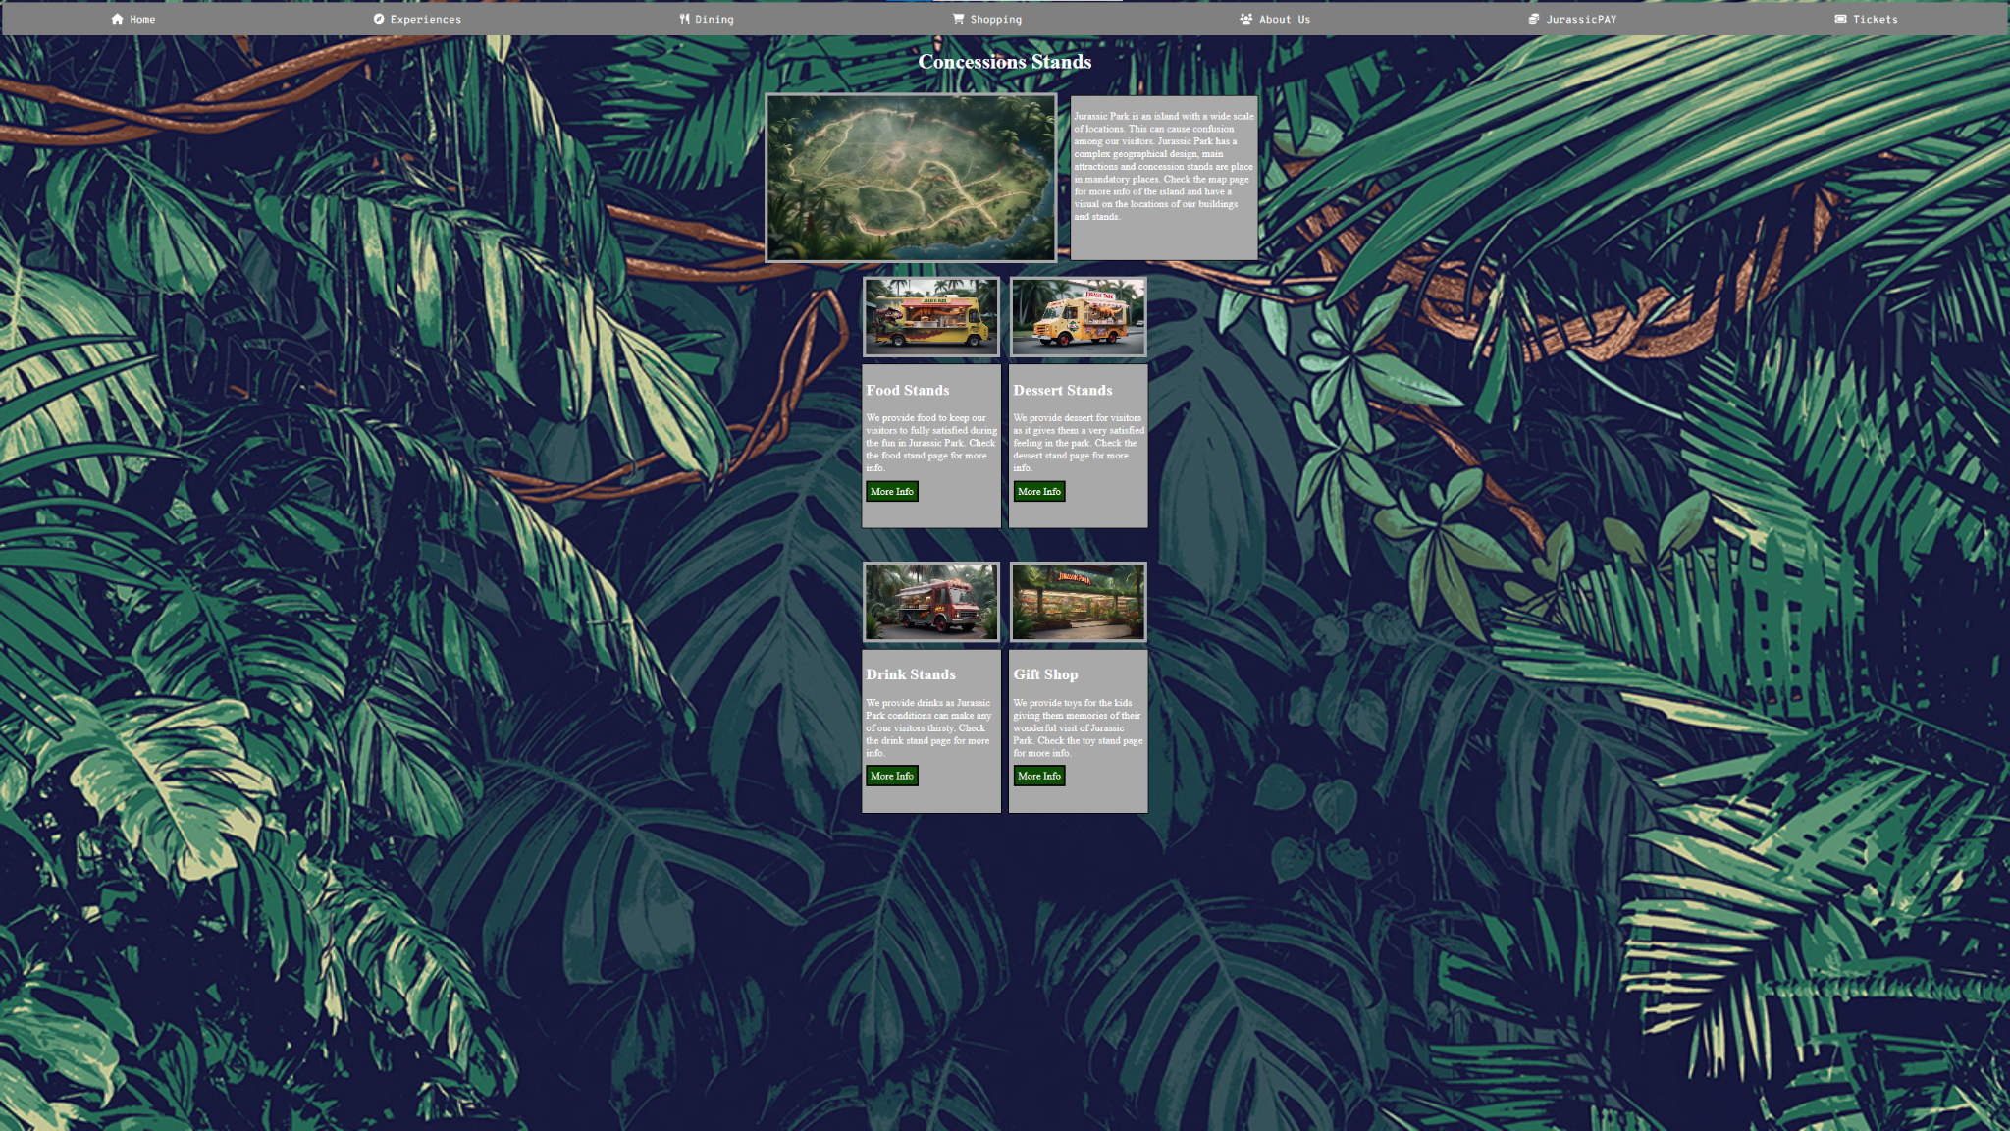
Conclusion

Slide 14

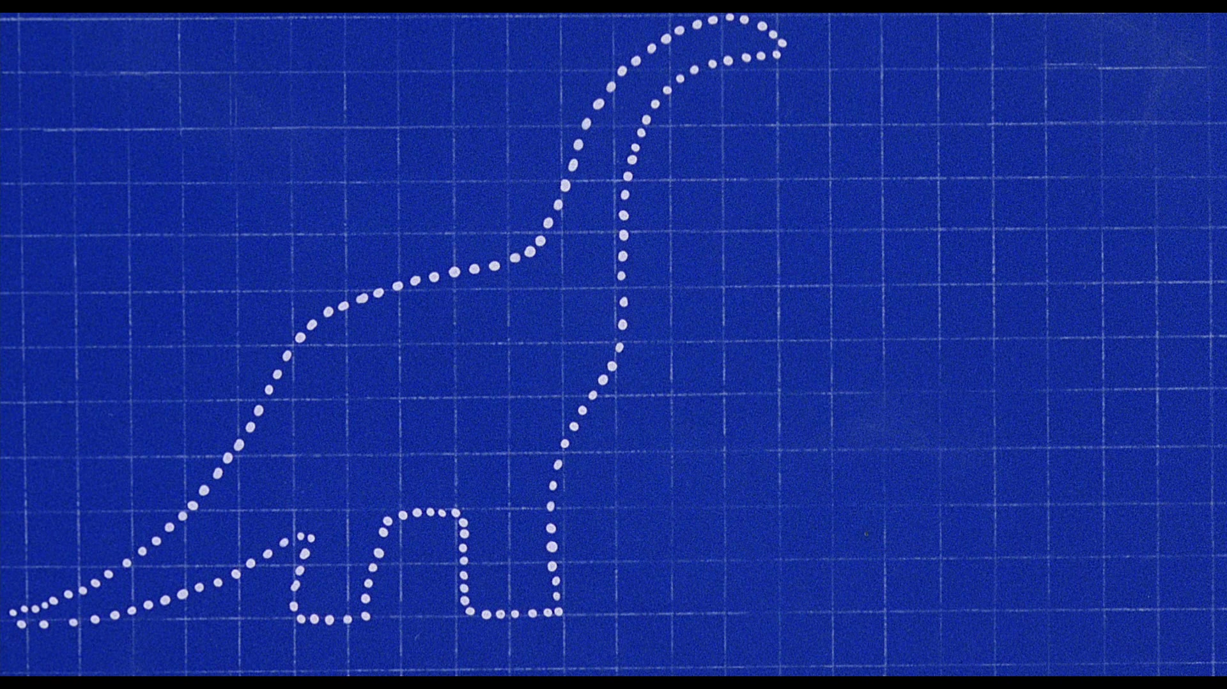

Q&A

Slide 15


Credits
Slides theme
Presentation template by Slides for Education.
Dinosaur silhouette and illustrations by Freepik.
Photos created by Unsplash and Freepik.

